Slide 1

Violence
presented by : mariam mohamed nady
mariam mohamed ezzelden mario ayman zarif
kerolos magdy rizkalla Al omda wasem

Slide 2

How does violence in cinema normalize violence in real life
The way violence is presented in the cinema and the amount in which it is shown increases the likelihood that the audience will be affected by it.

Slide 3
How does violence in cinema normalize violence in real life
It is like addiction, as it affects the subconscious of individuals and makes them associate violence with excitement and pleasure and makes them more accepting to see the victims’ pain and less sympathy for it and develops a feeling of carelessness to any harm that may happen to them or others as a result of this violence.

Slide 4
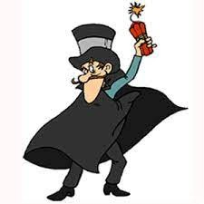
How does violence in cinema normalize violence in real life
people who watches these films will think that carrying a gun or make a bomb is something cool or fine or even normal.
That’s not the end; many criminals admitted that they got the crime idea from a film. Violence films may make some people say in their mind “why can’t I become a hero like in these films; kill, ”run, and blow up the whole world

Slide 5
How does violence in cinema normalize violence in real life
from here they will make a crime these people might kill and torture other people for just trying and become like their favorite film hero who do the same to innocent people
We conclude from this that watching violence in the cinema increases the possibility that people will become aggressive
Many researchers admitted that watching violence on TV can make people aggressive and can make them do crimes like these on TV

Slide 6
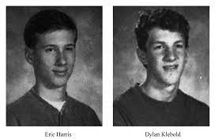
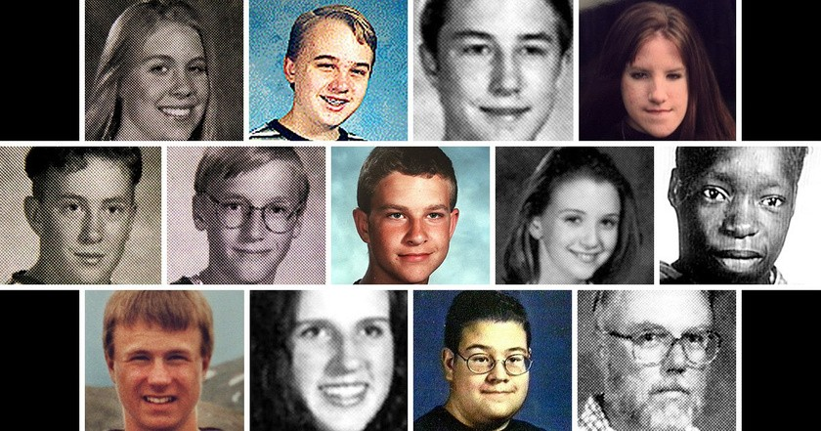
how does violence in cinema normalize violence in real life
On April 20/1999 Eric Harris and Dylan Klebold hysterically shot at Colombin High School in Littleton Colorado killing 13 people and injuring 21 before shooting themselves. When they broke into school, they each wore a black raincoat resembling the coat worn by the characters of Matrix a film that turned the hysterical shootout into breathtaking ballet like scenes.

Slide 7
thank you
presented by : mariam mohamed nady
mariam mohamed ezzelden mario ayman zarif
kerolos magdy rizkalla el omda wassem

